Slide 1


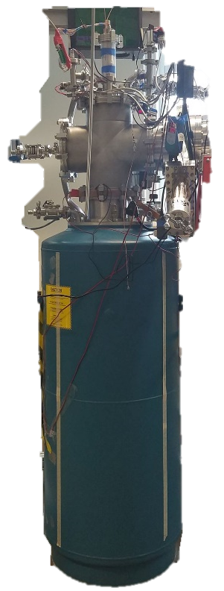
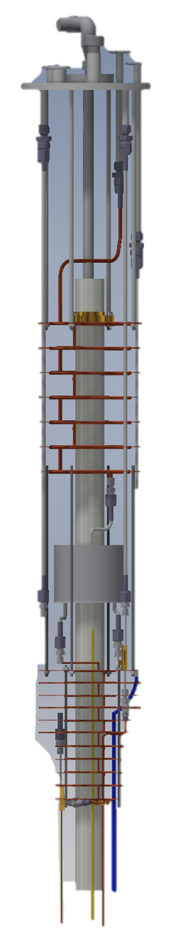
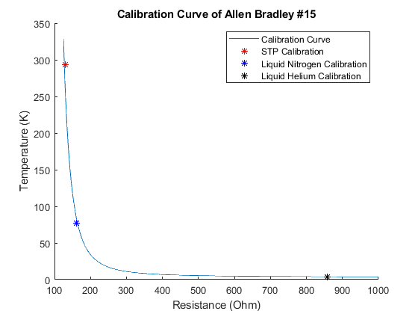
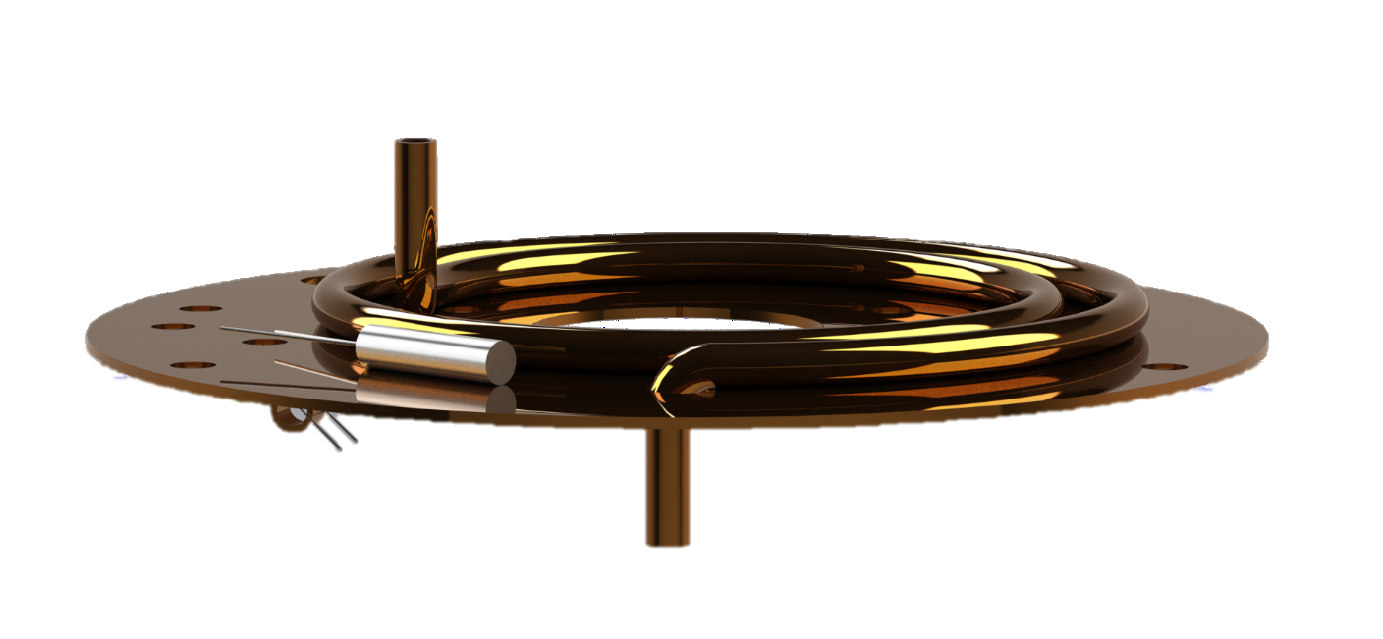
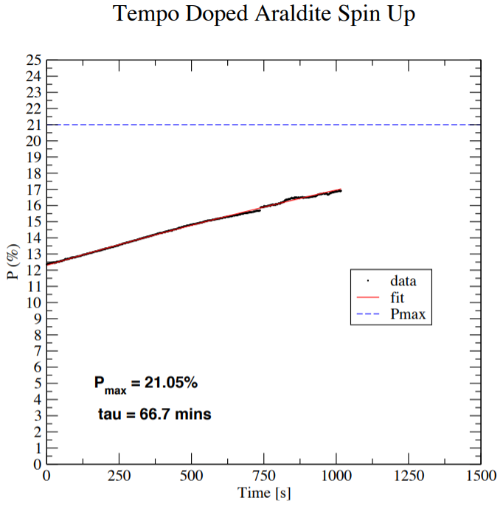
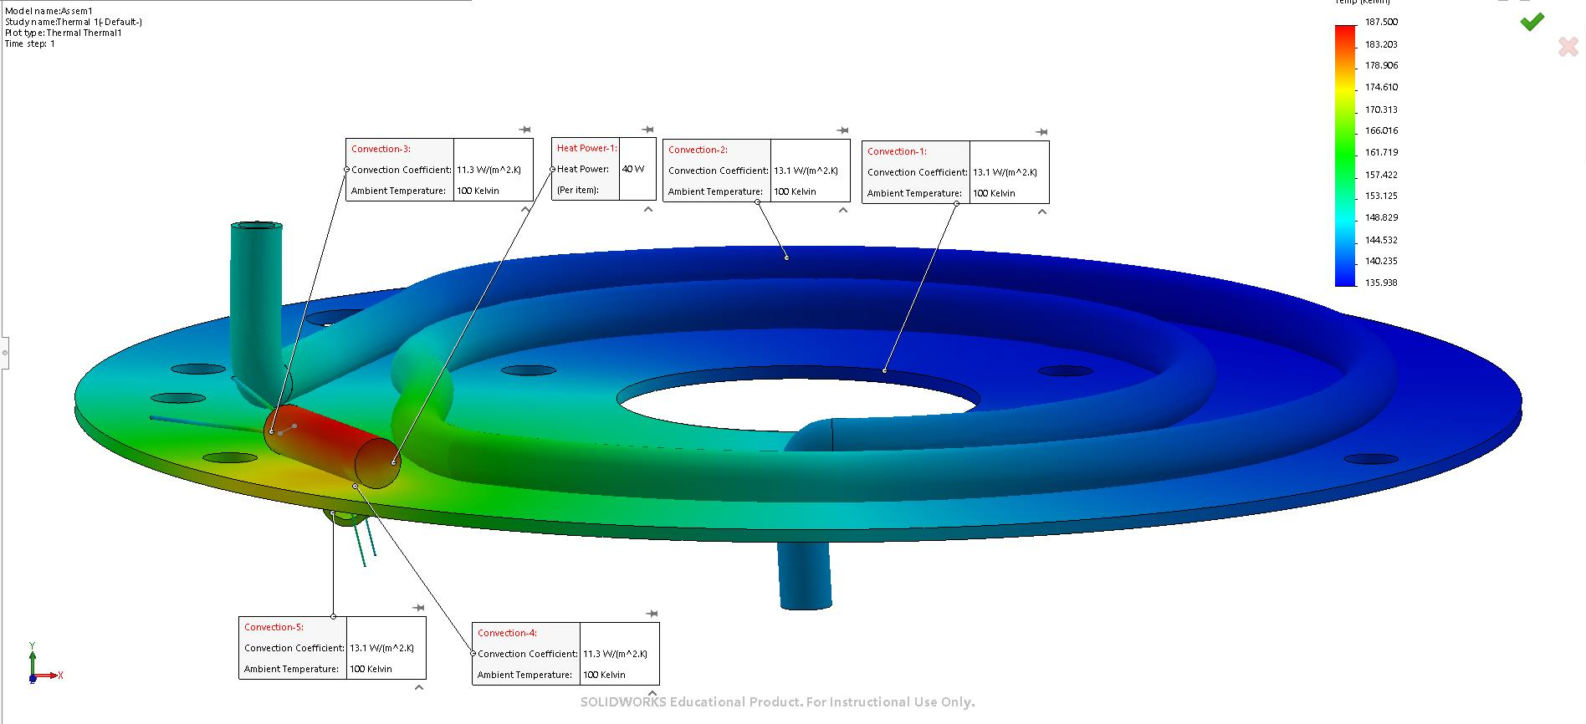
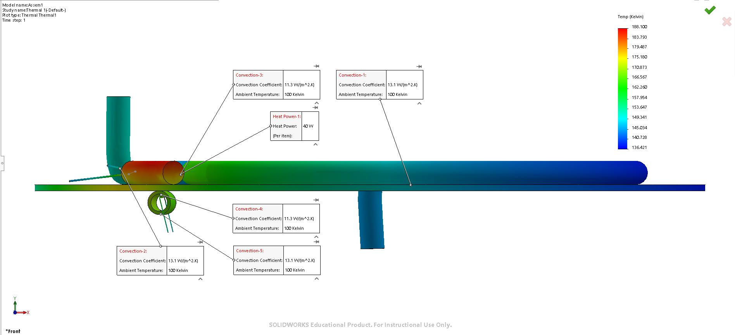
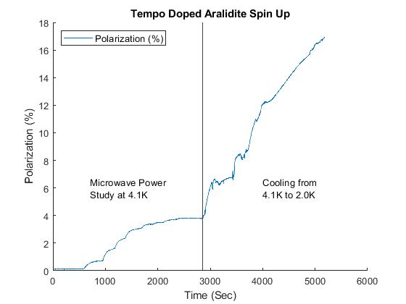
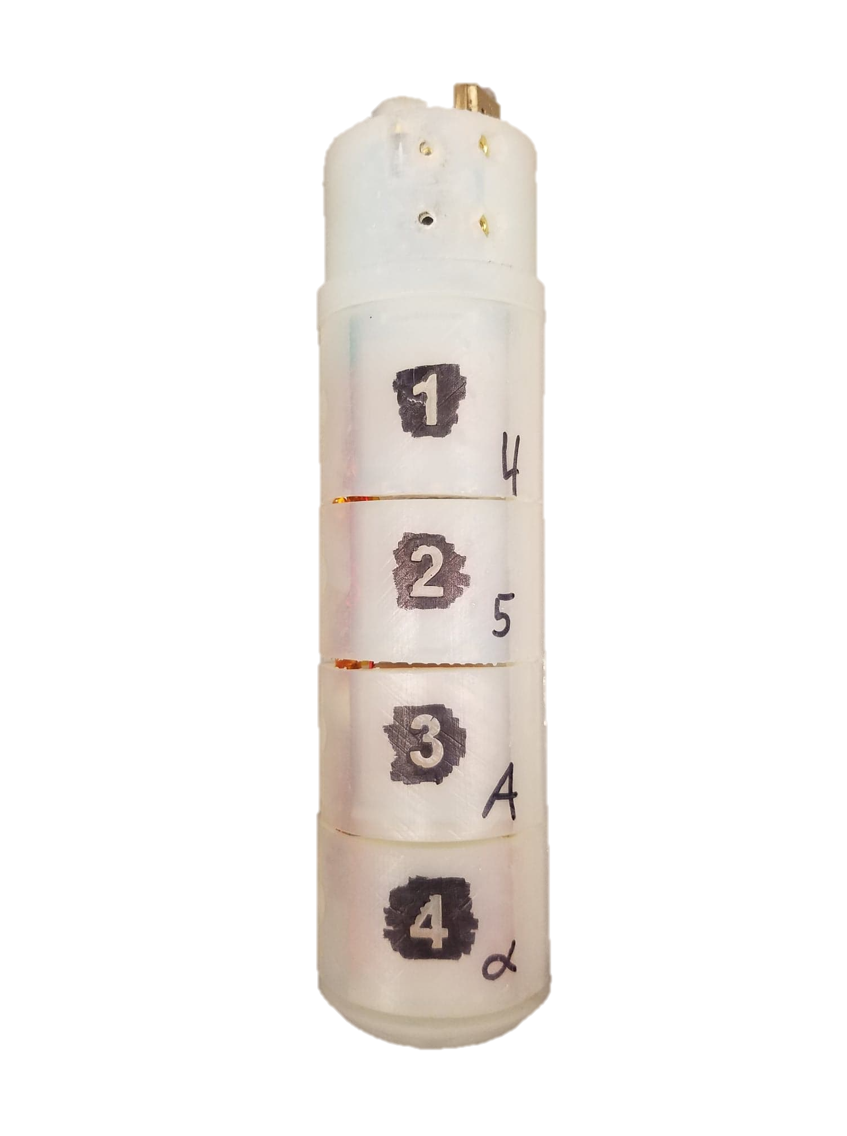
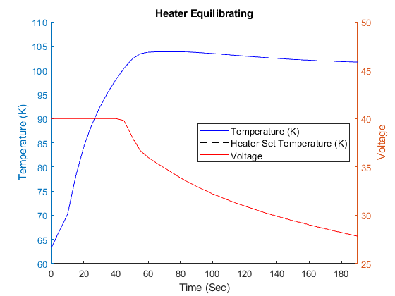
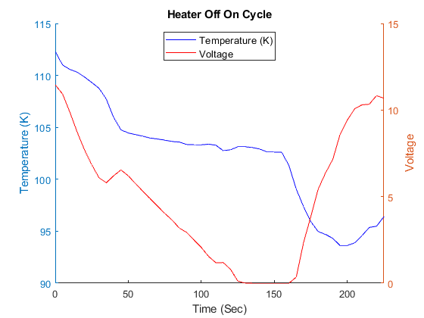

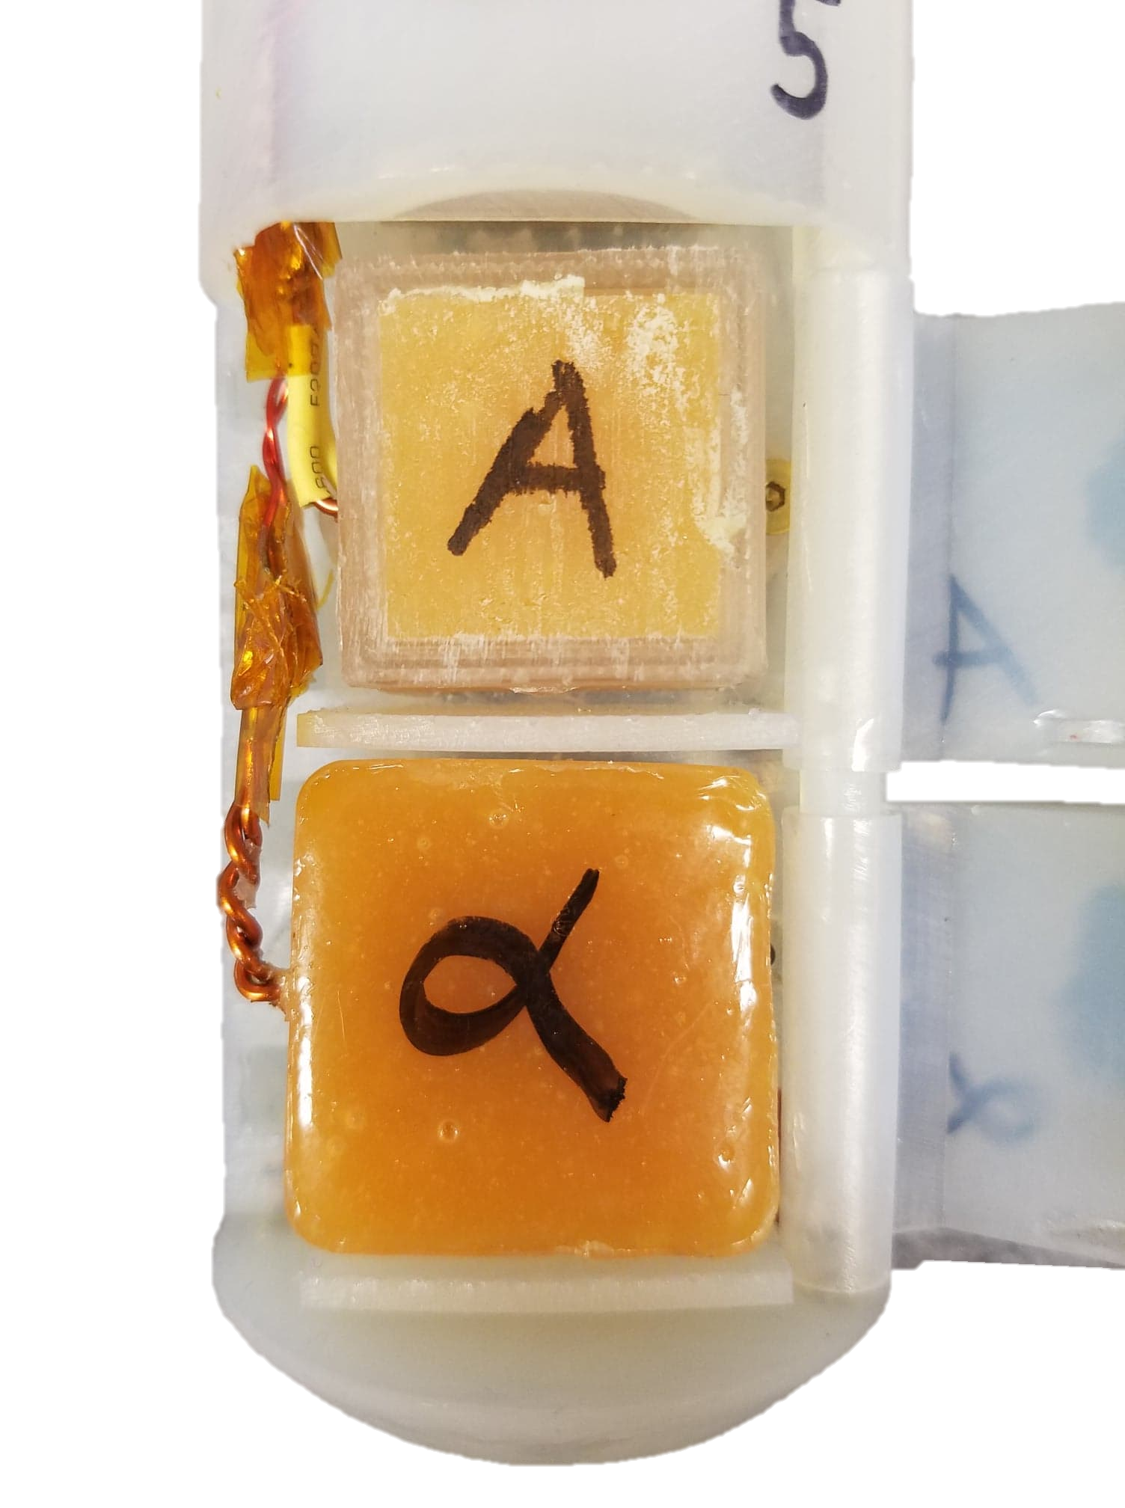
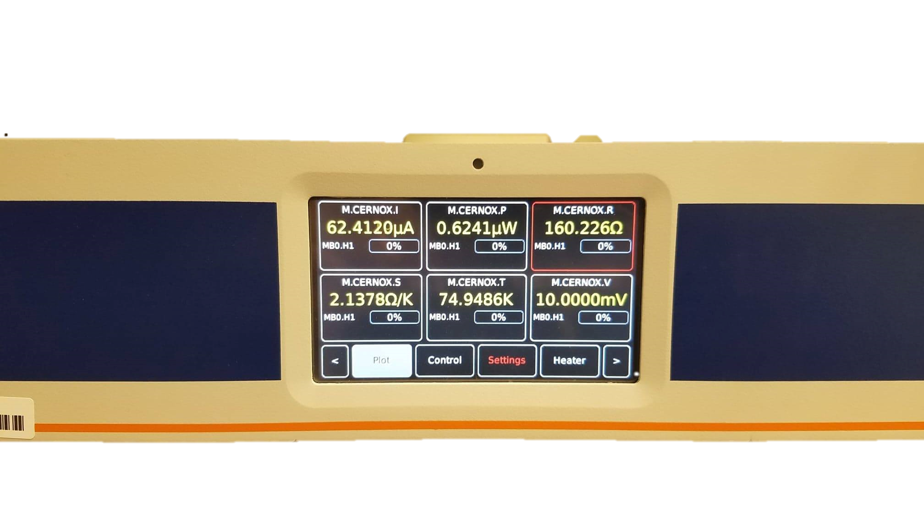
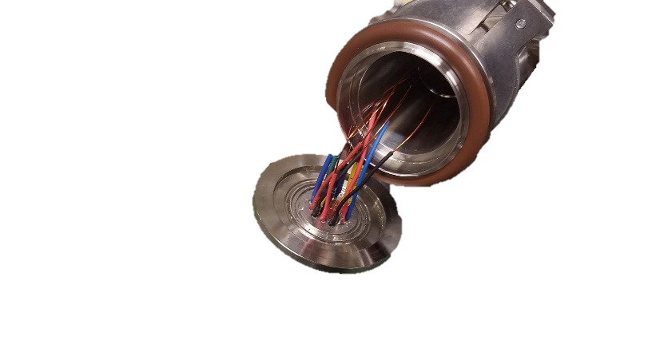
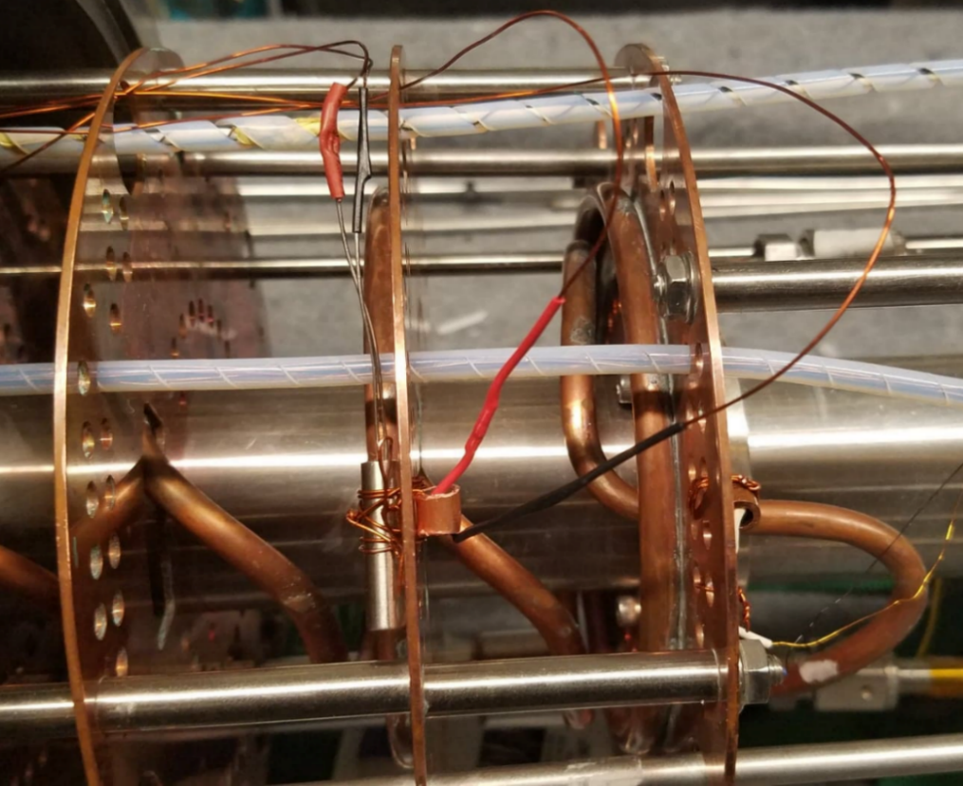
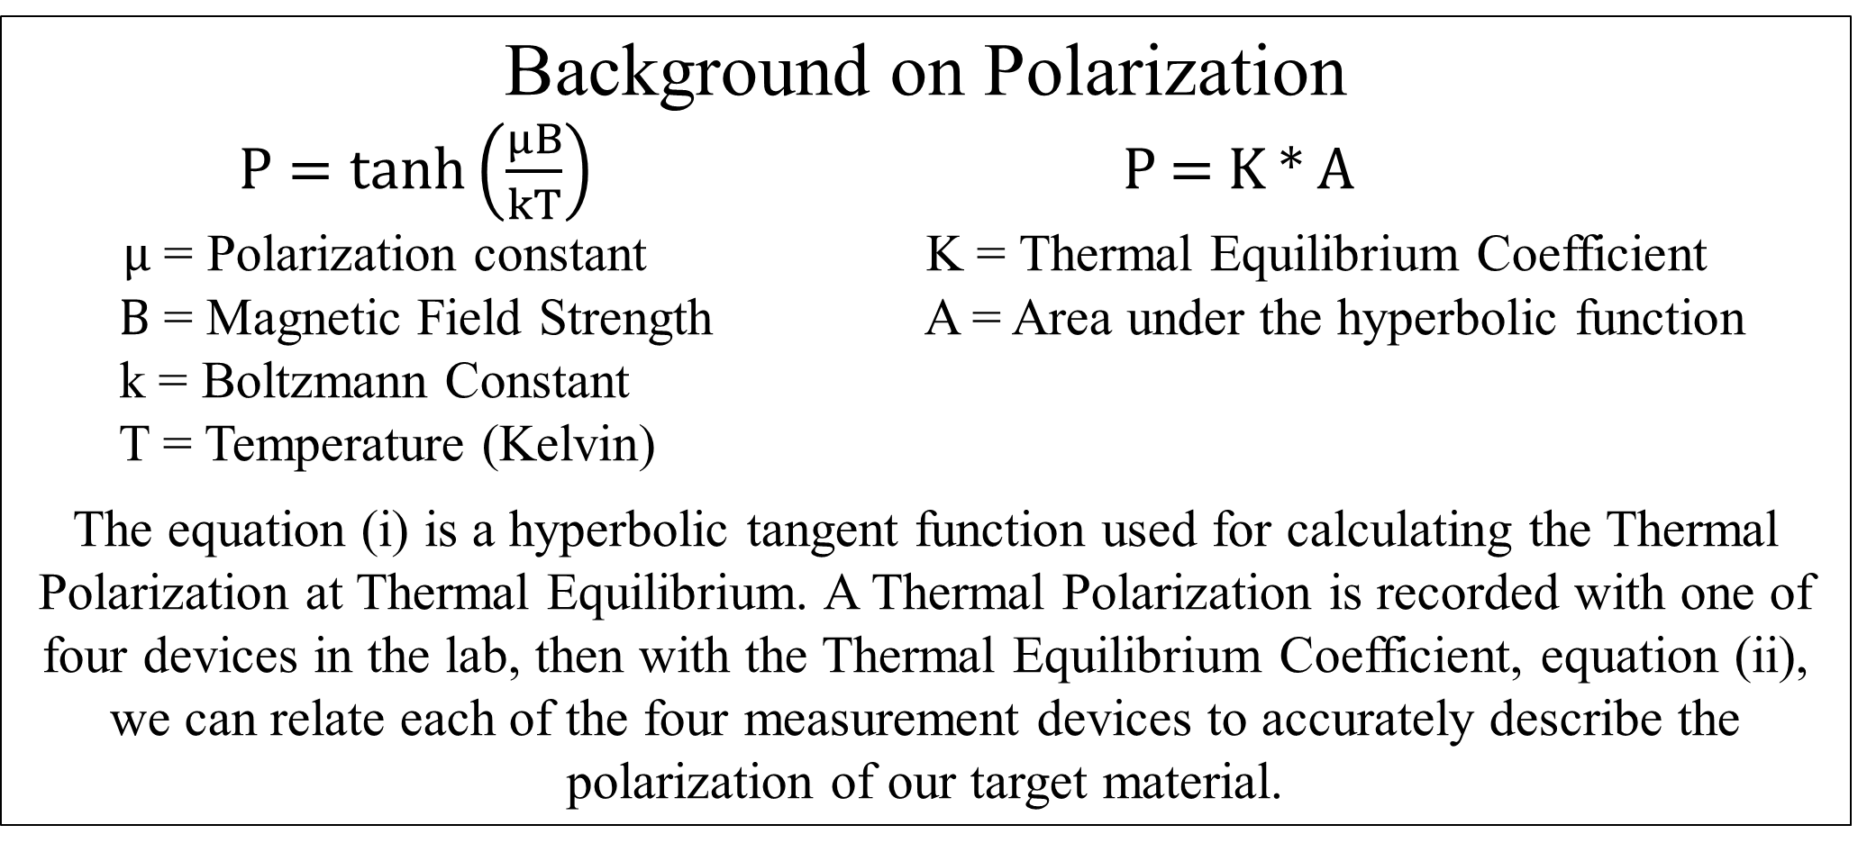
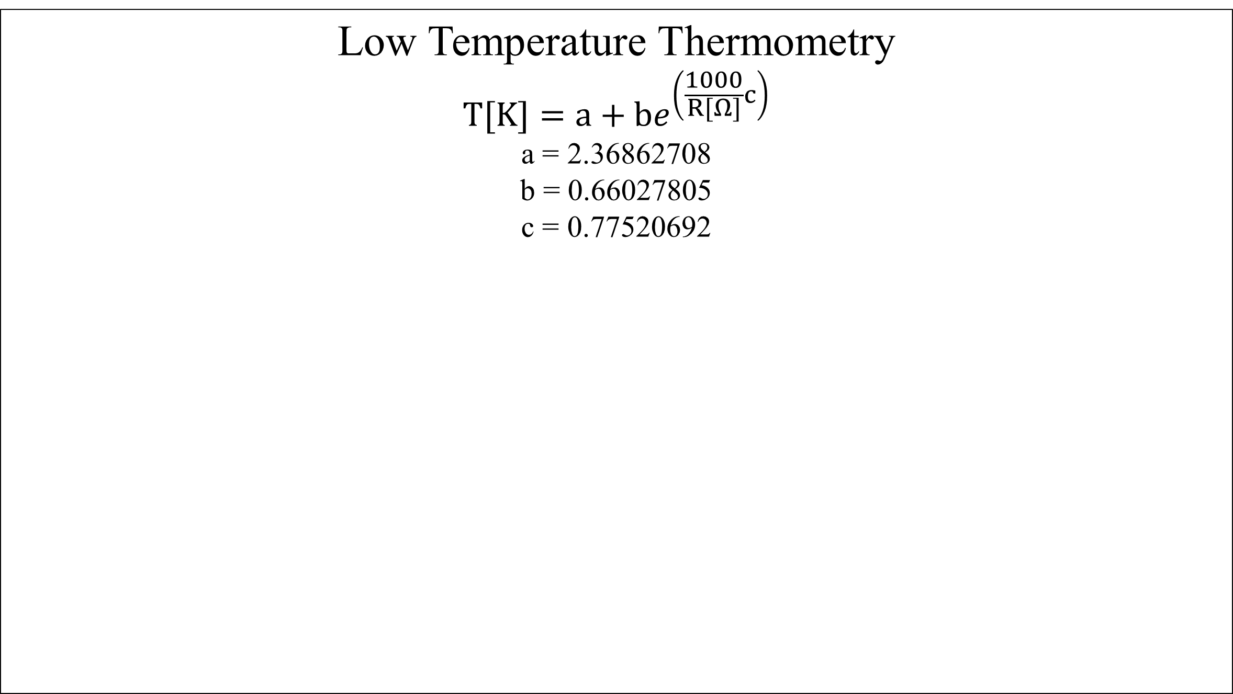
Vaporization of Liquid Helium and Polarization of TEMPO Doped Araldite
Thomas Collins
Advisor: Professor Karl Slifer
Background
My research at the Polarized Target Lab was to test polarizable proton rich target material for use in our DNP polarizer (as seen on the left). Secondly, to implement a system to vaporized liquid helium venting from the fridge space (as seen on the right). A deconstruction of the DNP polarizer is seen below.
Motivation
Araldite Epoxy doped with TEMPO has been found to be a suitable target material for dynamic nuclear polarization. A maximum proton polarization value of 21.05% percent has been achieved with a magnetic field of 4.998T and a temperature of about 1.2 K. The simple process of making targets that are free form, quickly reproducible, and relatively harmless in production make it an attractive option for DNP.
Low Temperature Thermometry
$$T[K]=a+be^{\left(\frac{1000}{R[Ω]}c\right)}$$
a = 2.36862708
b = 0.66027805
c = 0.77520692
Magnet and Fridge Assembly
Fridge Assembly
An Allen Bradley Resistor was used to calculate the temperature on the adjacent side of the heating baffle. Previous to instillation a calibration must occur with the given equation and values listed above. These values were predetermined by the manufactures. Allen Bradley Resistors are Negative Temperature Coefficient resistors, meaning they exhibit an exponential increase in resistance in low temperatures.
Background on Polarization
$P=\tanh\left(\frac{μB}{kT}\right)$ P = K * A
$μ$ = Polarization constant K = Thermal Equilibrium Coefficient
$B$ = Magnetic Field Strength A = Area under the hyperbolic function
k = Boltzmann Constant
T = Temperature (Kelvin)
The equation (i) is a hyperbolic tangent function used for calculating the Thermal Polarization at Thermal Equilibrium. A Thermal Polarization is recorded with one of four devices in the lab, then with the Thermal Equilibrium Coefficient, equation (ii), we can relate each of the four measurement devices to accurately describe the polarization of our target material.
Heating Cartridge and Thermometry SOLIDWORKS rendering of the heating cartridge and Allen Bradly thermometry assembly. Located On the second baffle above the separator.
Thermal Analysis of the Heating Cartridge
Post Cooldown, a thermal analysis of the heating cartridge was done to observe its effect on the baffle and copper coil tubing. In this analysis the ambient temperature was chosen to be 100K, and the heater power is set to 40W. These characteristics and the thermal coefficients for each part ensured an accurate representation. Figure (i) shows the dissipation from a top down viewpoint and Figure (ii) shows a side profile. Thermal analysis was done using SOLIDWORKS.
Tempo Doped Araldite Spin Up
Post cooldown an analysis of our target polarization was done to determine our maximum polarization. Through analysis of our cryostat environment, magnetic field strength and other factors we determined that our polarization would have reached a maximum of 21.05% if our study had continued.
Tempo Doped Araldite Target
Target stick containing the Alpha and Beta target in 3rd and 4th cups. Located on the end of the target ladder on the bottom of the fridge.
Power Study of Tempo
The polarization of a target material can be directly effected with a microwave enhancement. A power study of the Tempo Doped Araldite was preformed at two temperature ranges. Incremental changes in the microwave power can be seen by increasing polarization.
Thermal Results
The following graphs consist of experimental data collected during the March 2019 Cooldown.
.
Tempo Doped Araldite Targets
Tempo Doped Araldite Targets were produced in the Chemistry room in Demerit Hall. Stable titroxyl radical Tempo was mixed with 1:100 part Araldite Epoxy Resin, which was then mixed with 1:1 part Araldite Epoxy Hardener. The small Tempo admixture provides the paramagnetic radicals necessary for dynamic nuclear polarization technique. This allowed us to create free form polarization targets with a magnet wire coil centered in the material.
Mercury iTC
A Mercury iTC is a cryogenic programmable intelligent temperature controller. This was used to monitor temperature and resistance, while controlling the heating cartridge though a set point temperature or heat flow (%).
Heating Element
19 Pin Connection
A D9 connector ran from the back of the Mercury iTC to the 19 pin connector. A 19 pin connector was used for electrical connections between the lab space and the vacuum environment.
Heating Element
The heating cartridge and Allen Bradley resistor separated by a copper baffle. Wiring consisted of magnet wire and spade clips connections.
Figure (i) is a graphical visualization of the heater equilibrating to a set point temperature of 100 K.
Figure (ii) shows the heater turning off from an set temperature, once 150 sec pass the heater is turned on again.
Reference
Noda, Yohei. "Thermosetting polymer for dynamic nuclear polarization:Solidification of an epoxy resin mixture including TEMPO." Elsevier. 09 Dec. 2014. <https://reader.elsevier.comAE/reader/sd/pii/...>.
Acknowledgements
A huge thank you to all the members of Slifer and Long Lab, Karl Slifer, Elena Long, David Ruth, Nathaly Santiesteban, and Tristian Anderson for all the support.

Slide 2
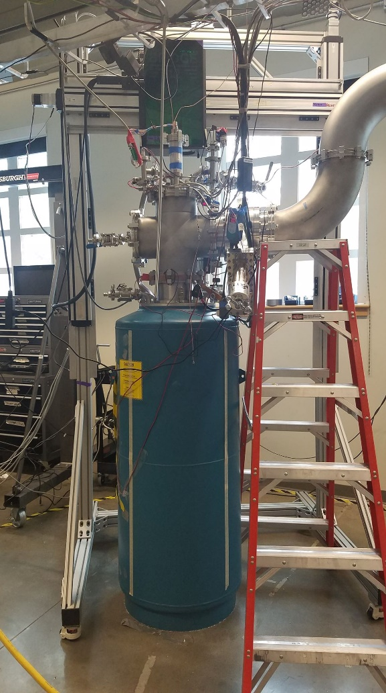
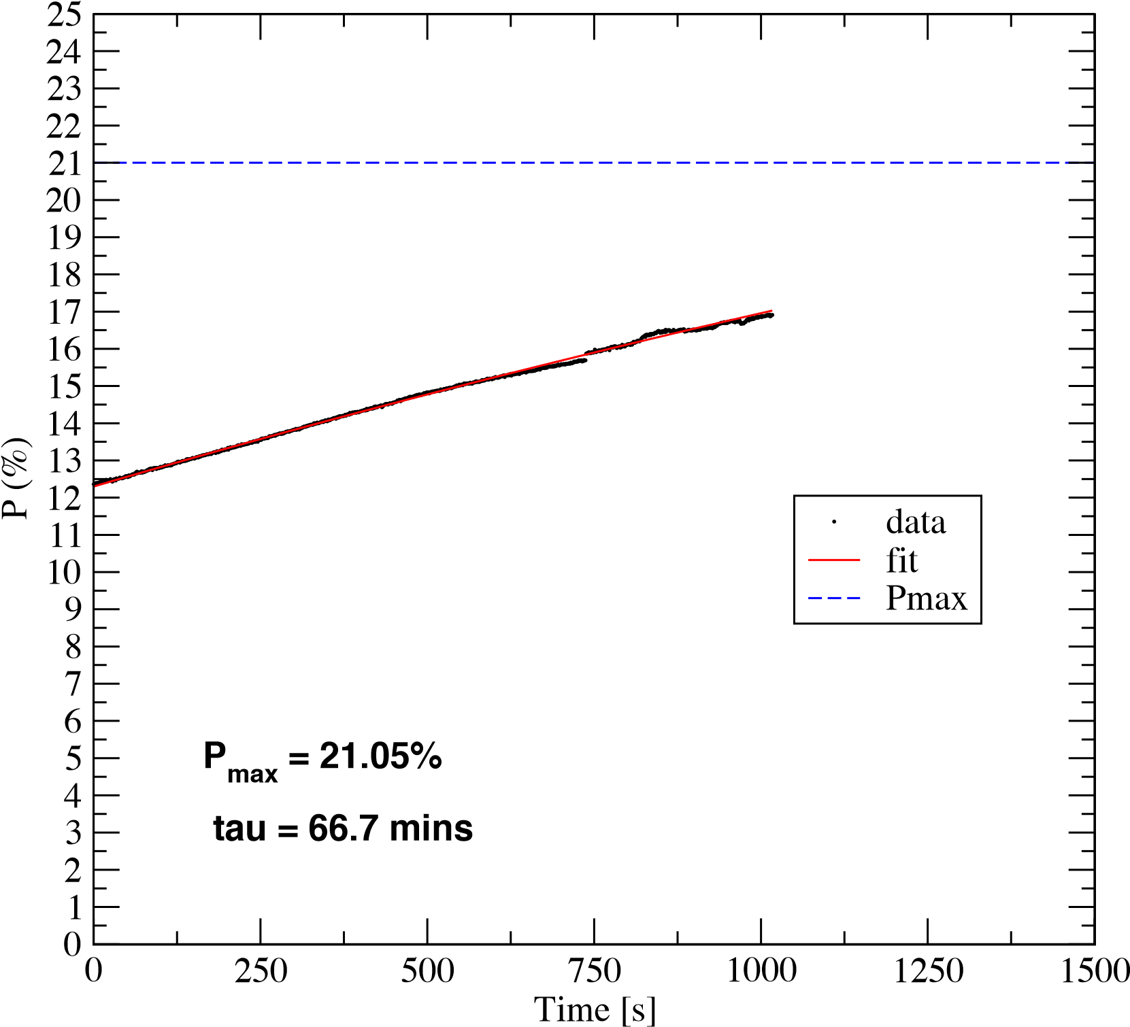
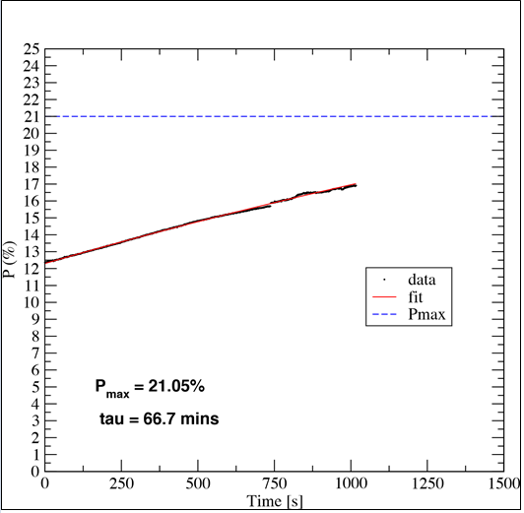
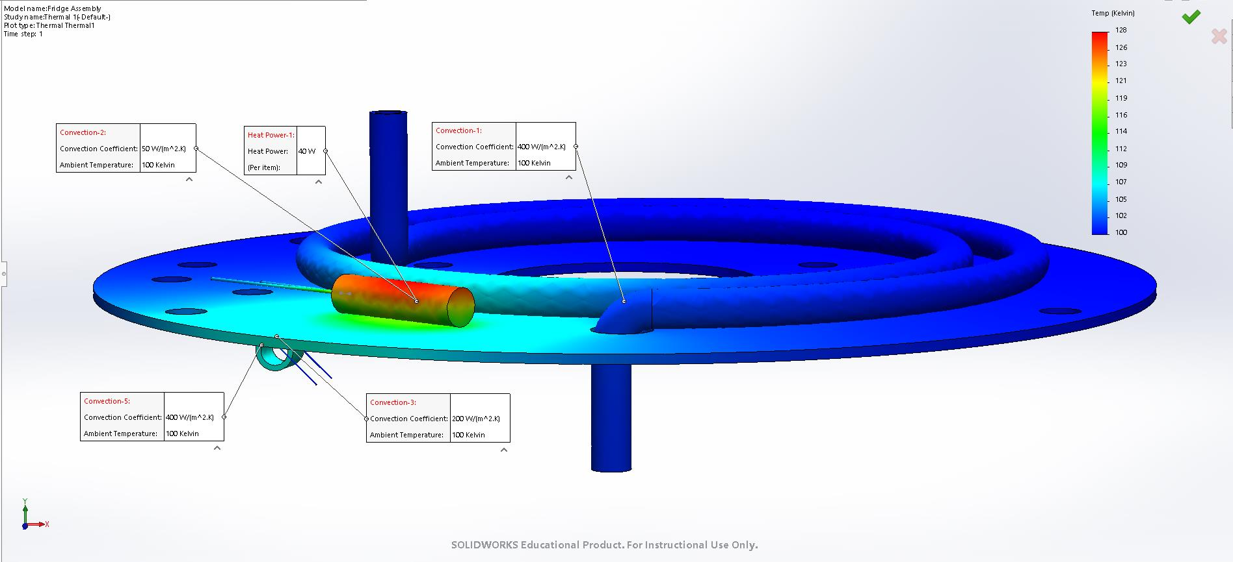

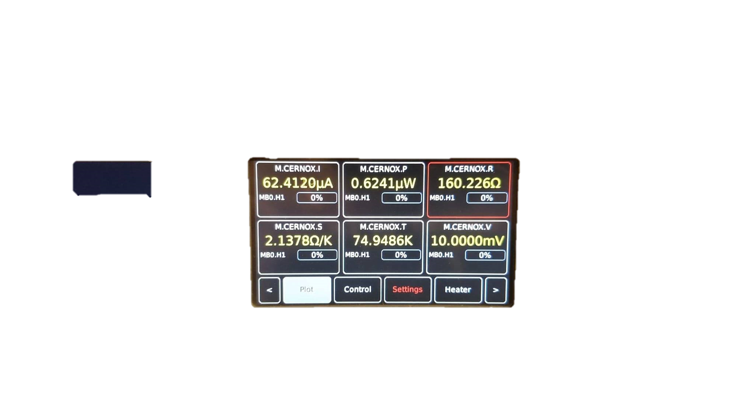
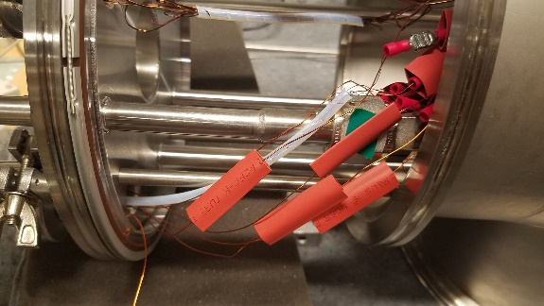
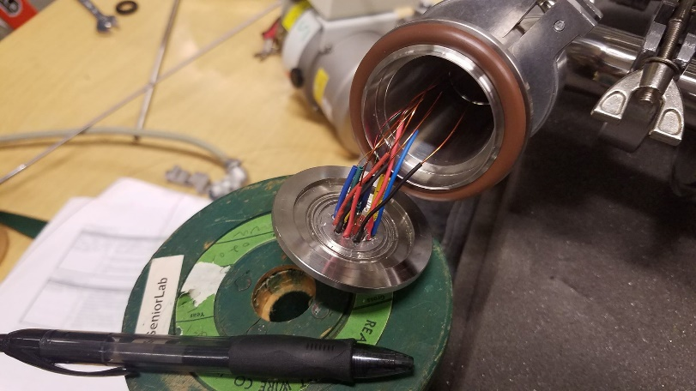
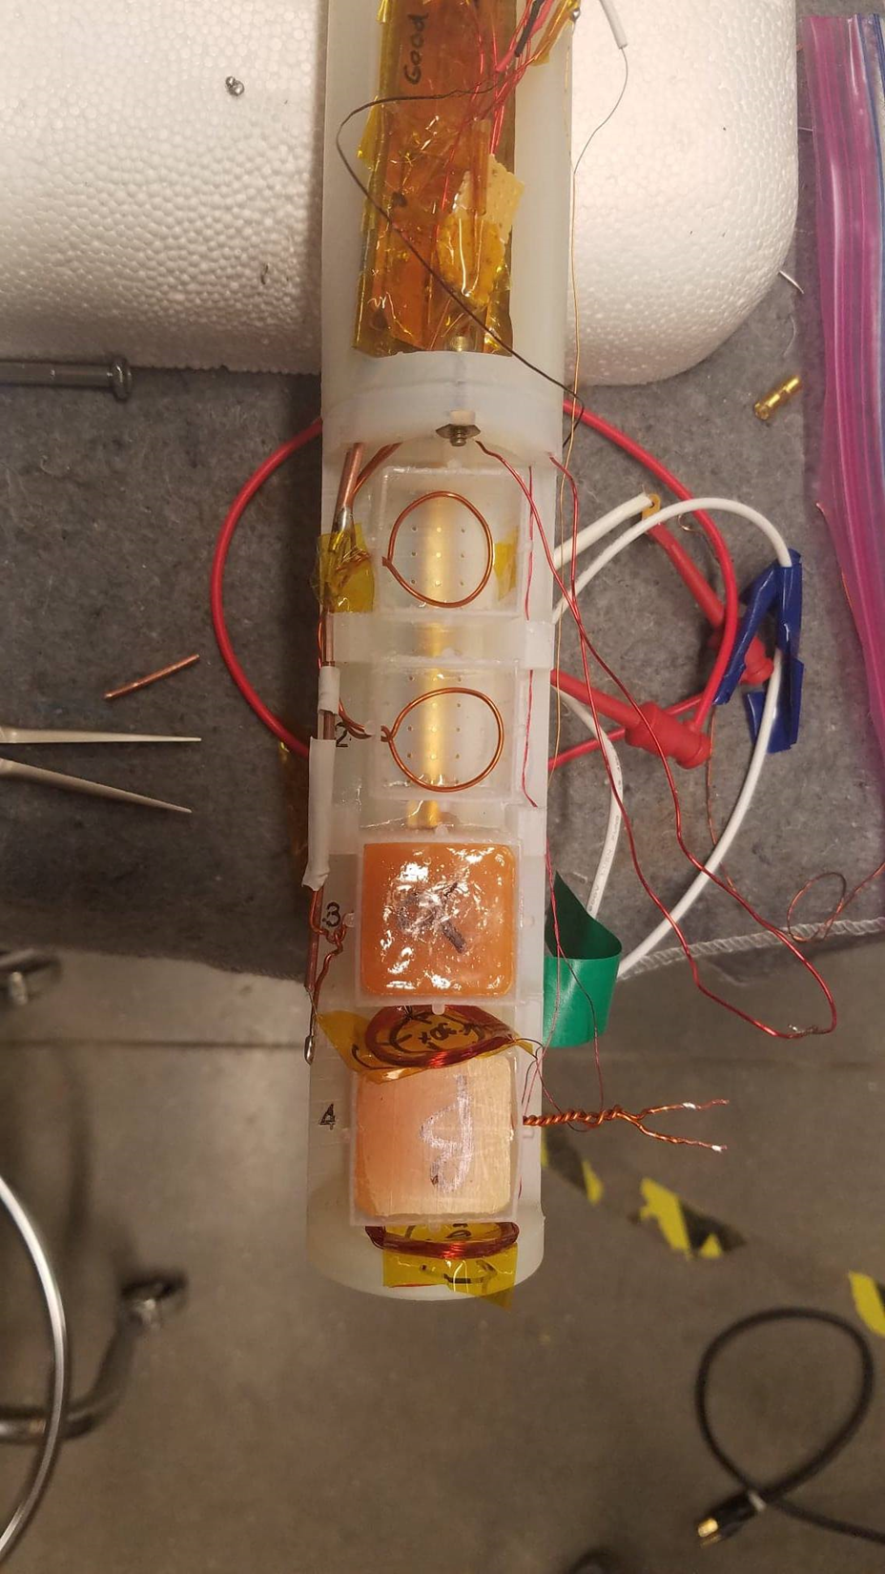
A set point temperature would use a PID feedback loop to regulate the cryostat temperature. (See Figure i). The heat flow (%) setting would send the heating element with a set % of the max voltage.
The placement on the copper baffle allowed the baffle to act as a secondary heating element through conduction. Its placement within the fridge was determined to directly impact the venting liquid helium while having no effect on the colds pace at the bottom of the helium evaporator.
It carried four leads, two for thermometry and two for the heating cartridge.

Slide 3

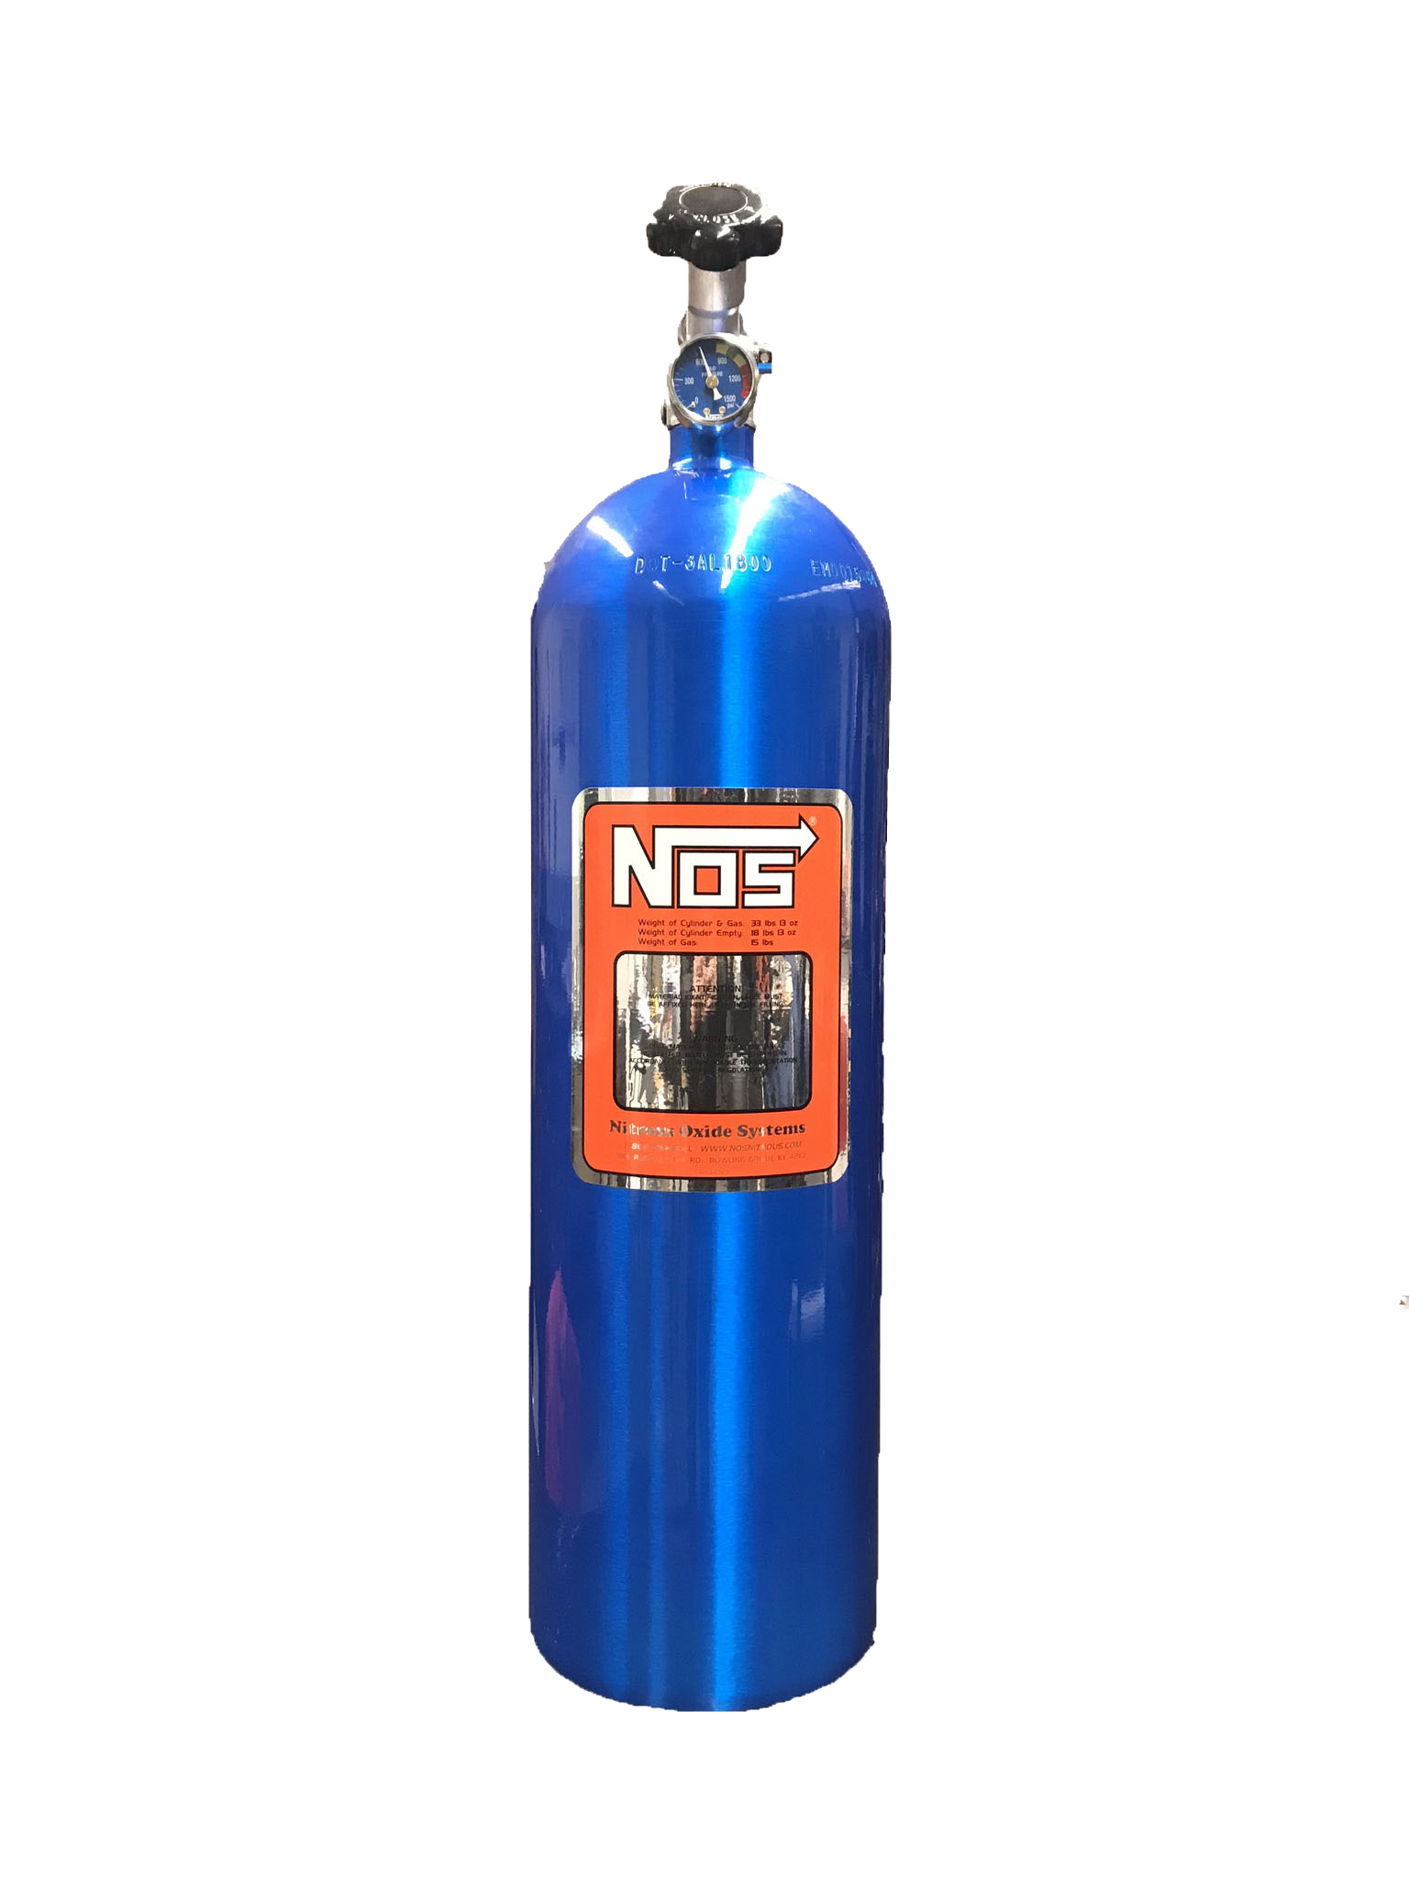


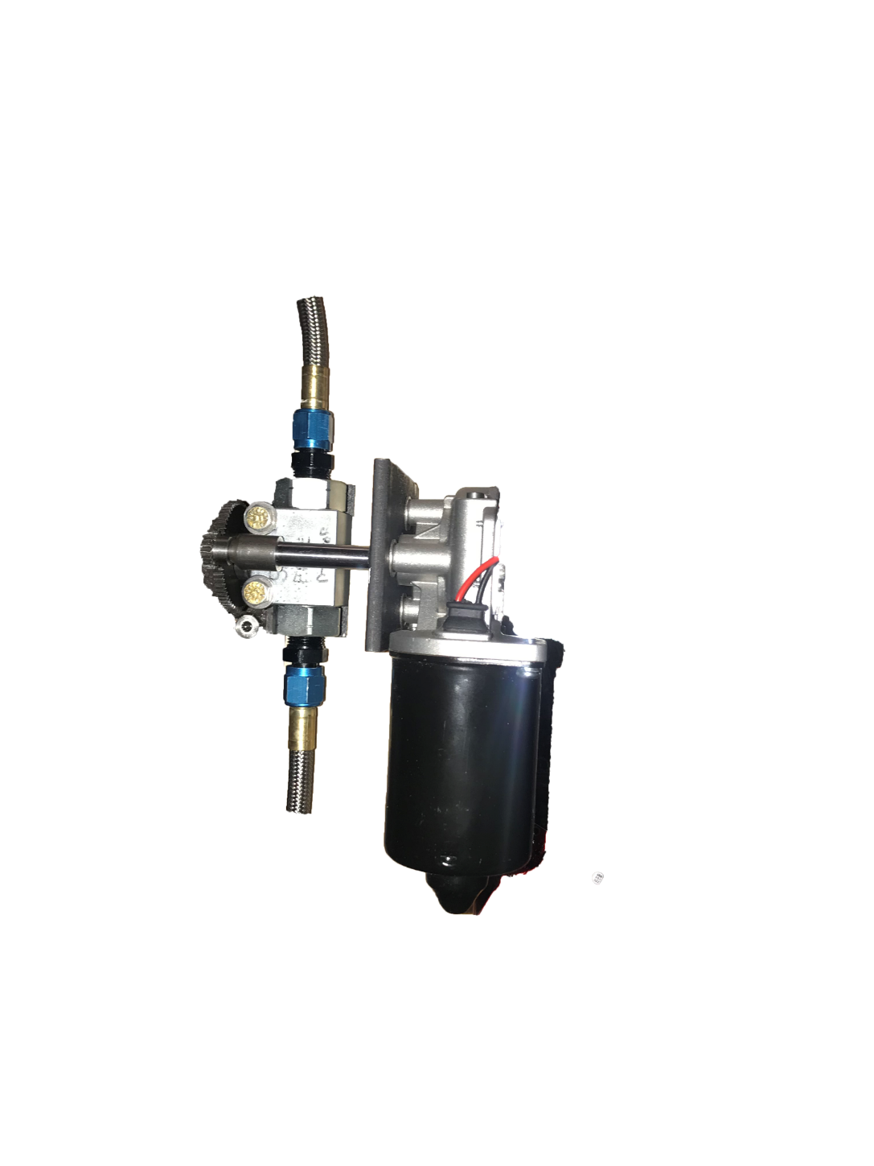
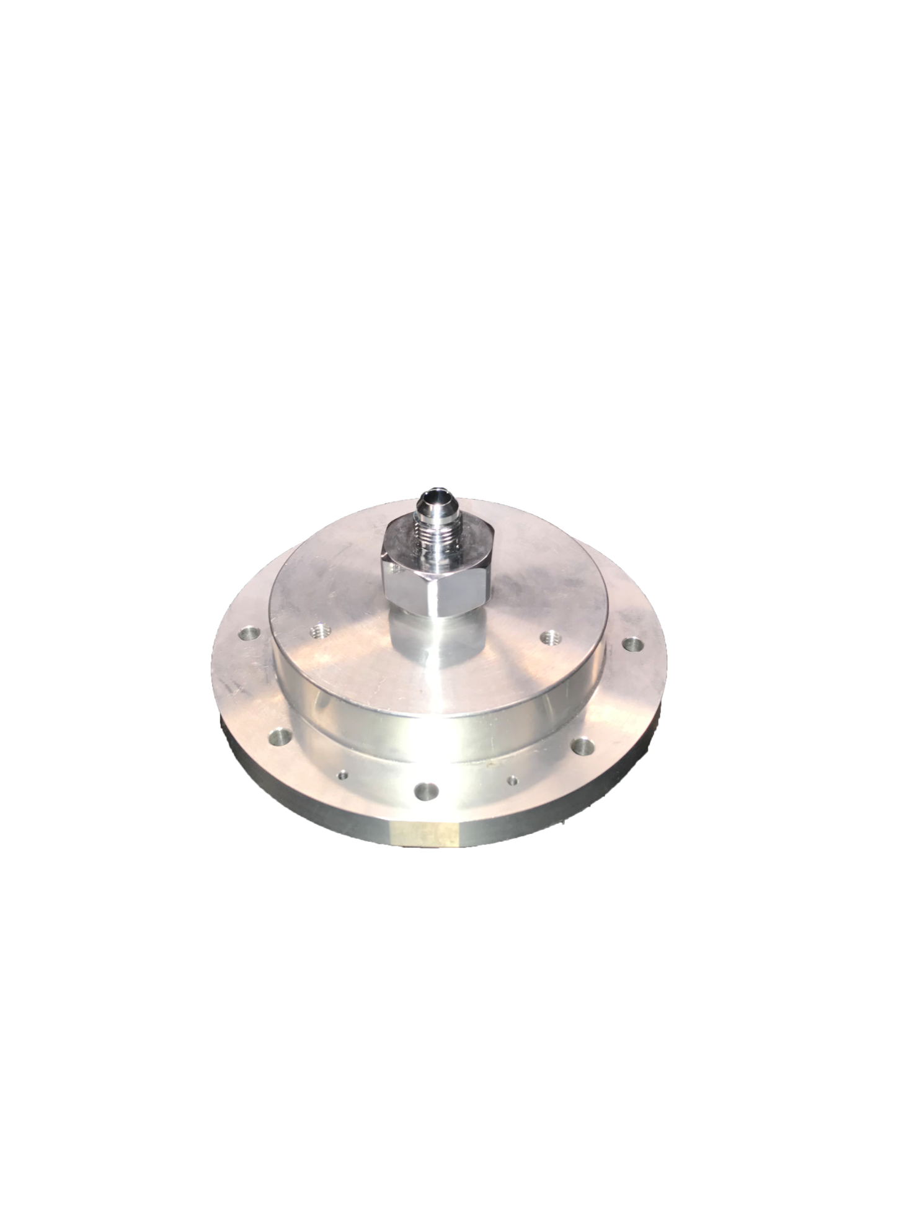
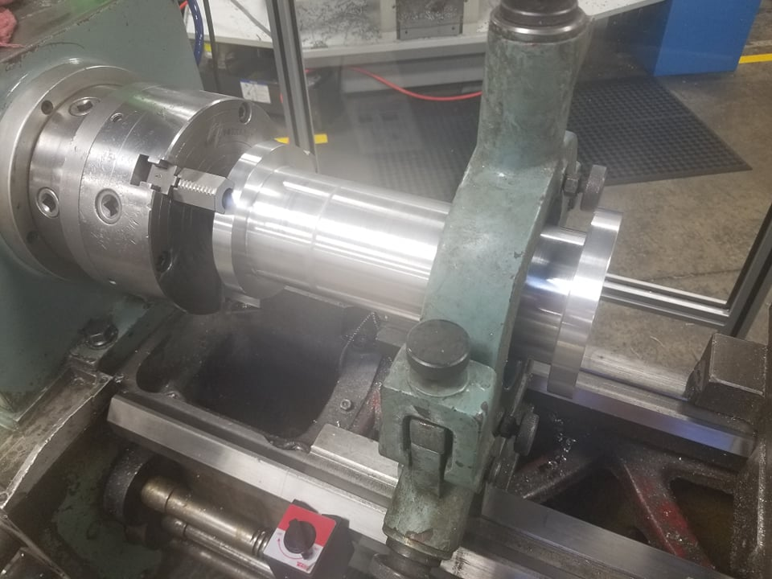
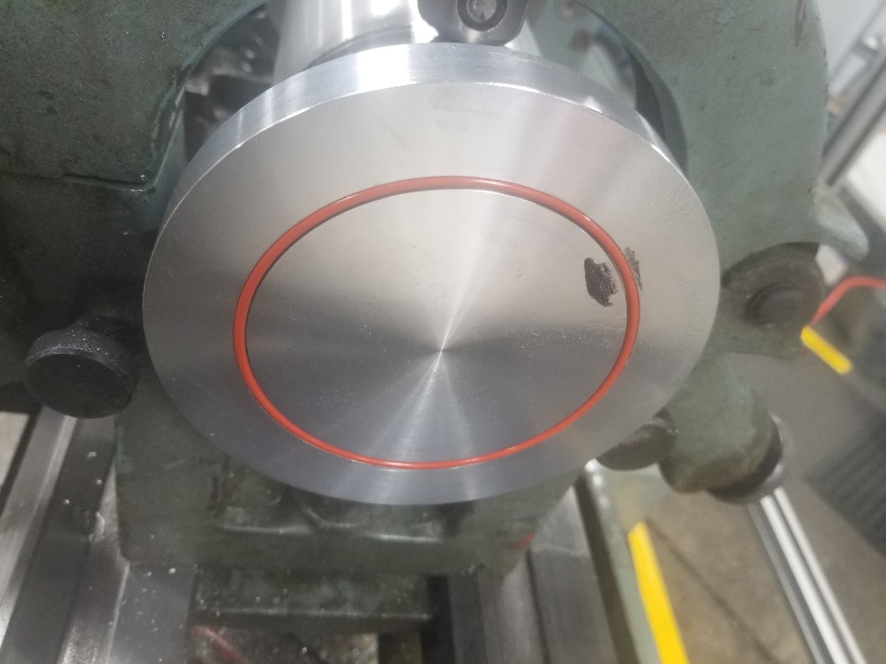
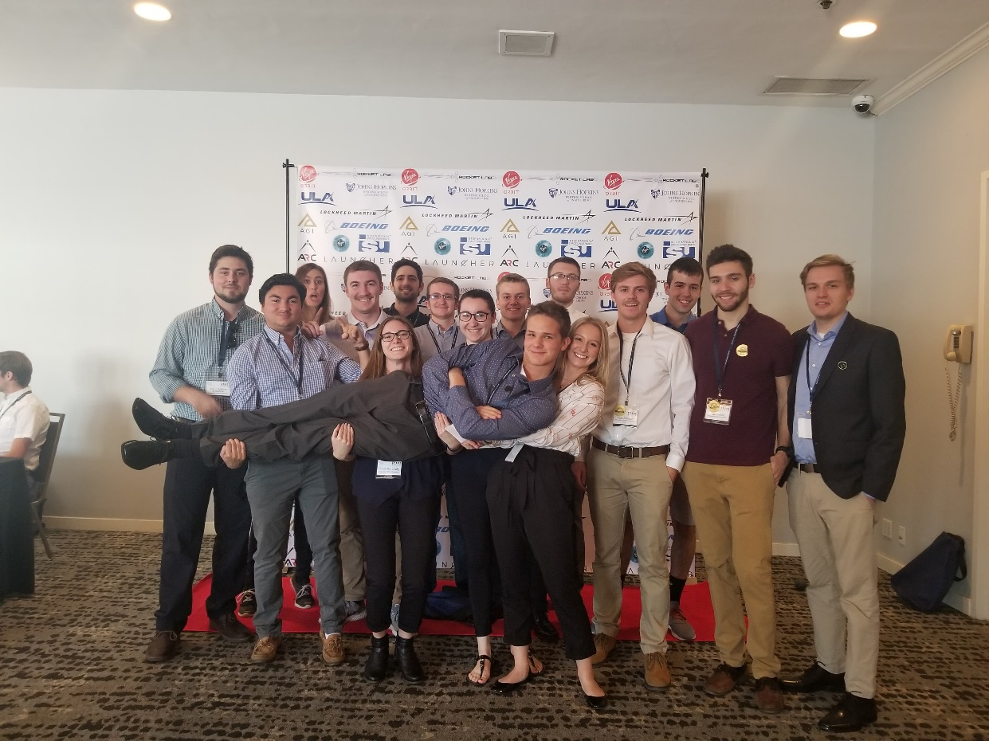

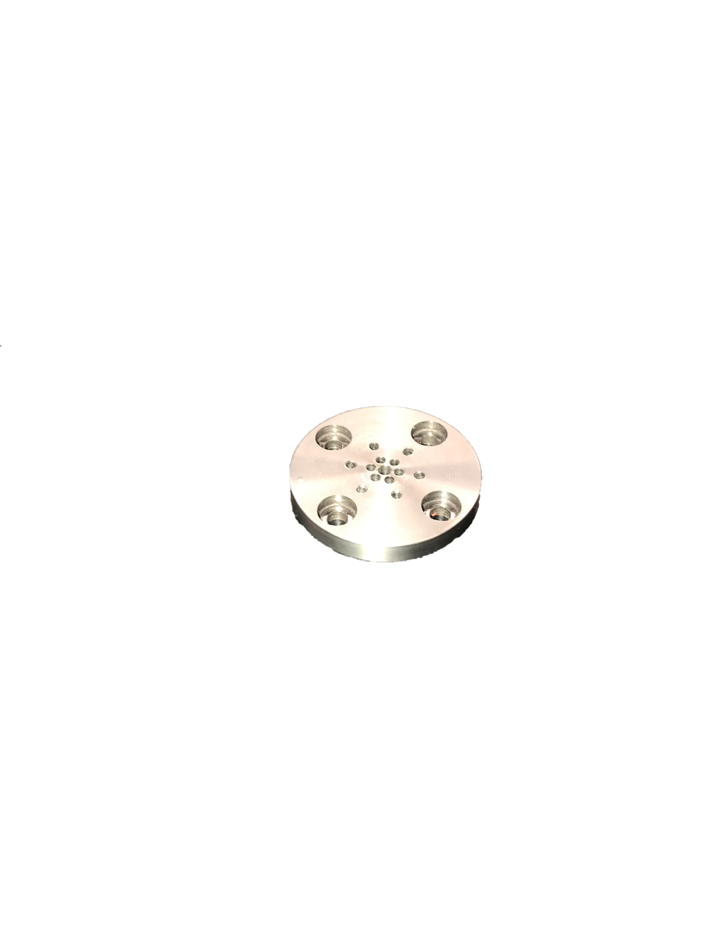
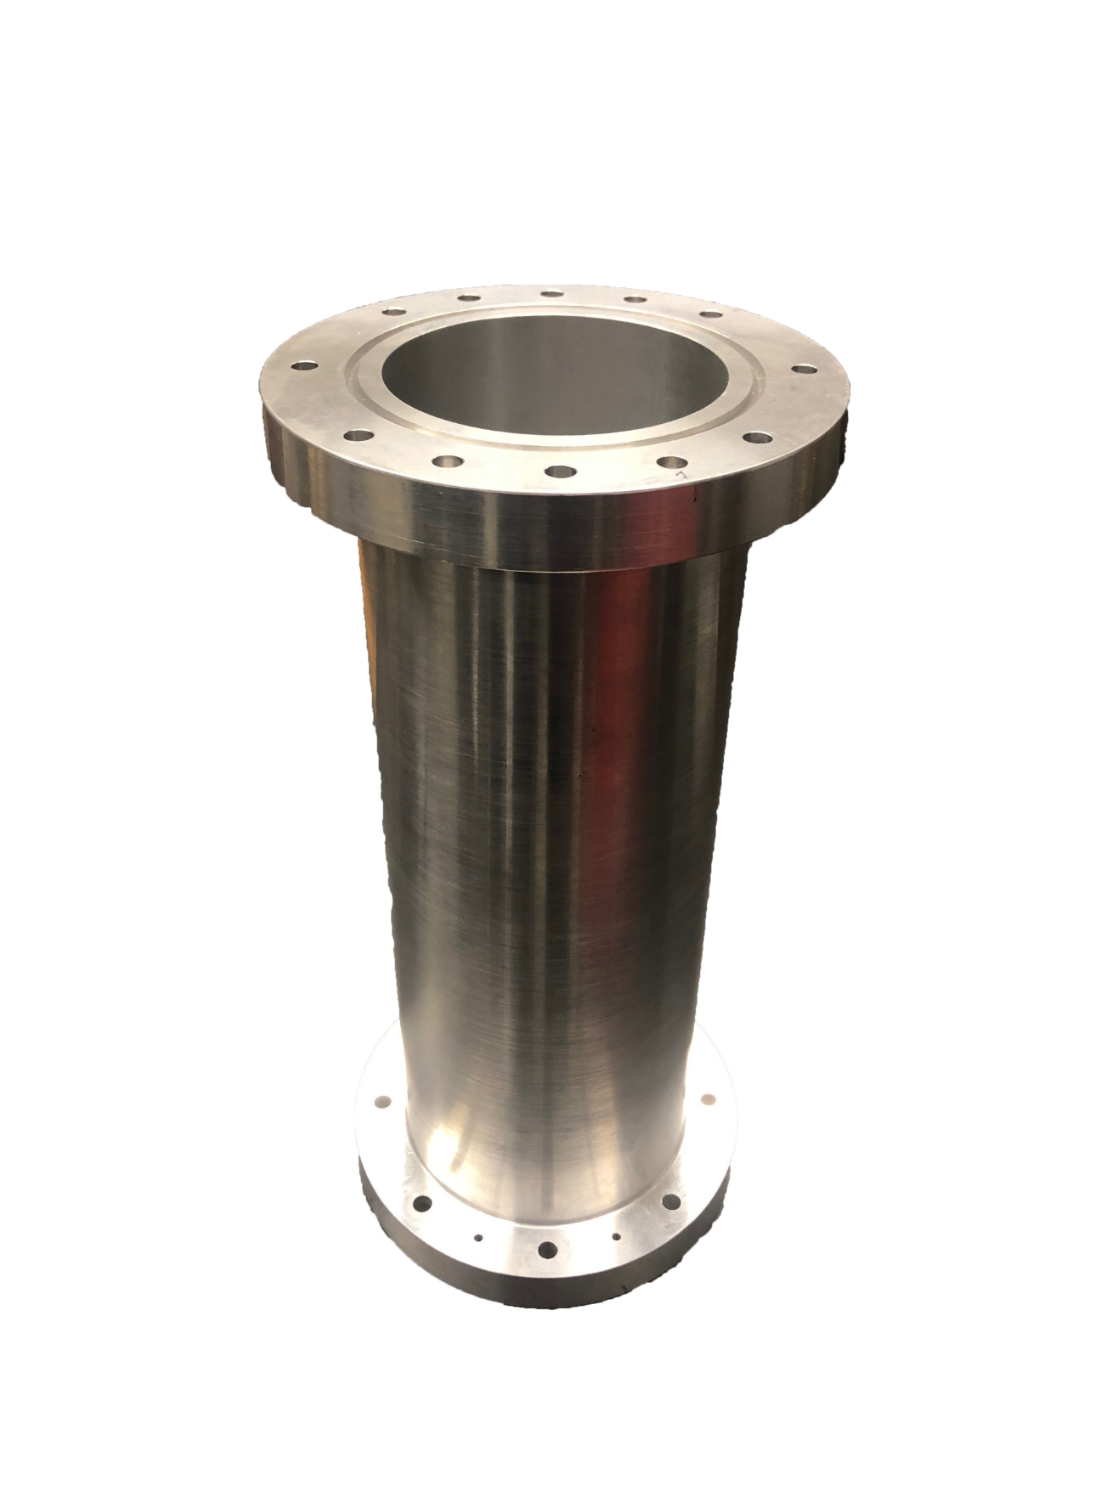
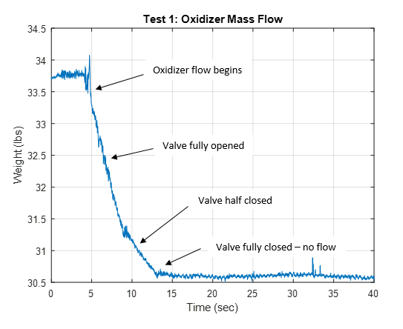

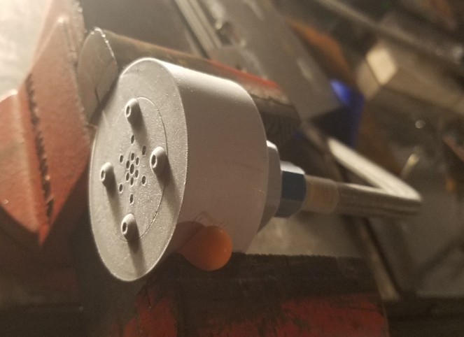
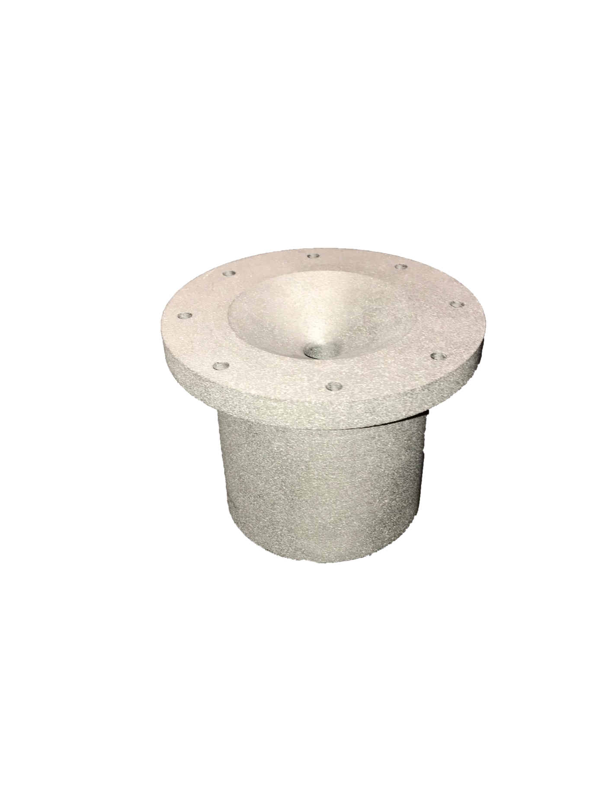
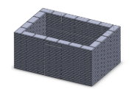

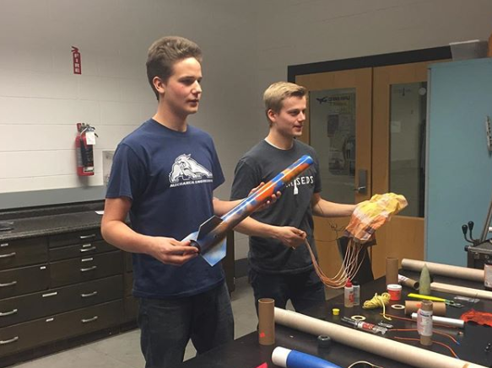

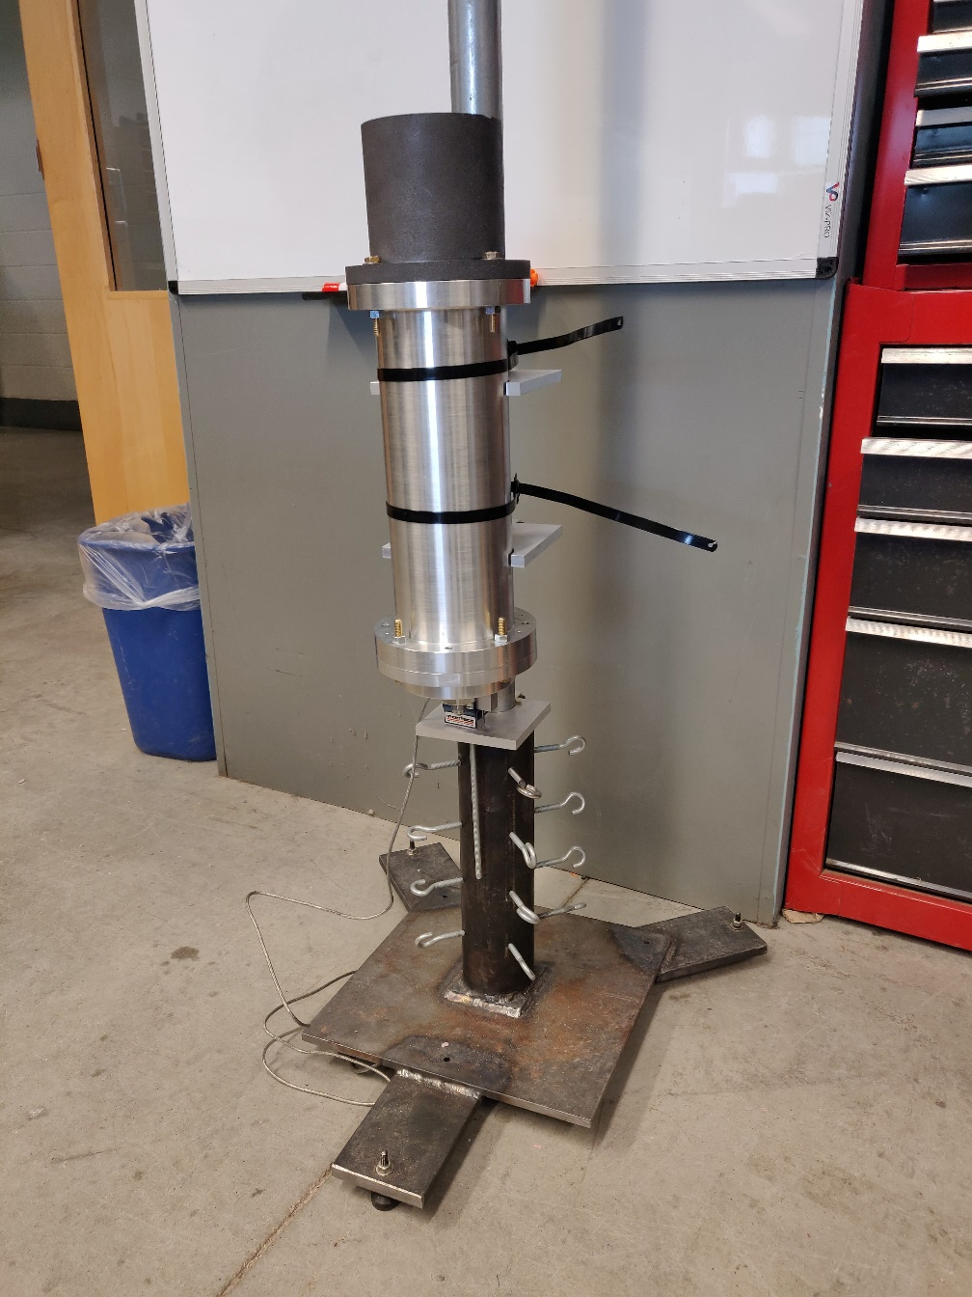
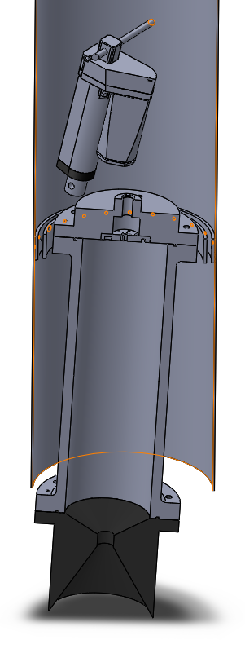
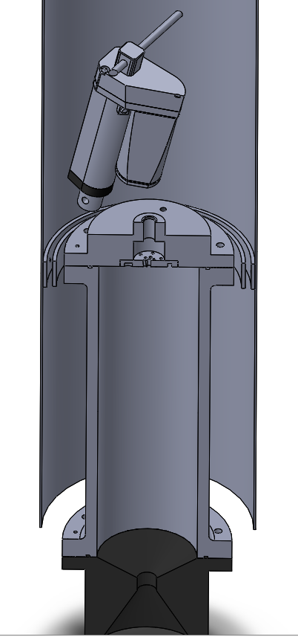
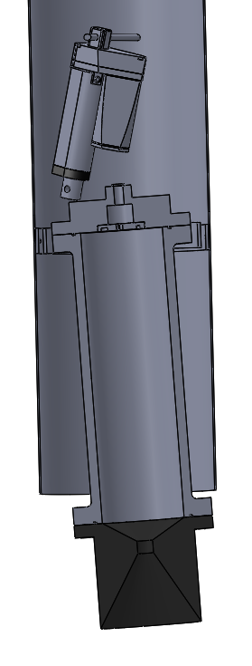
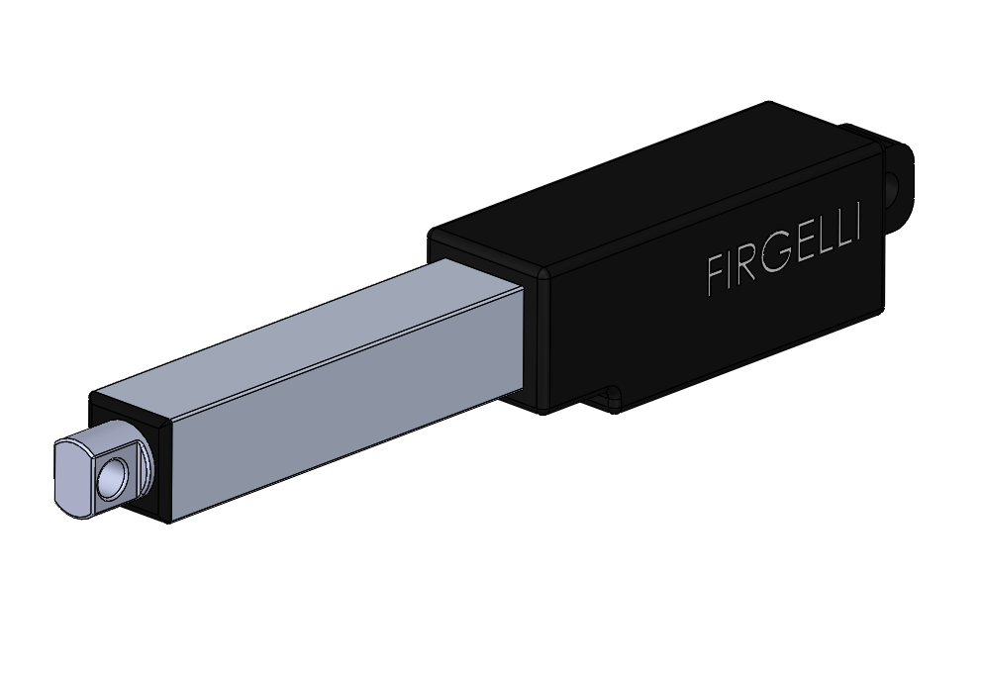
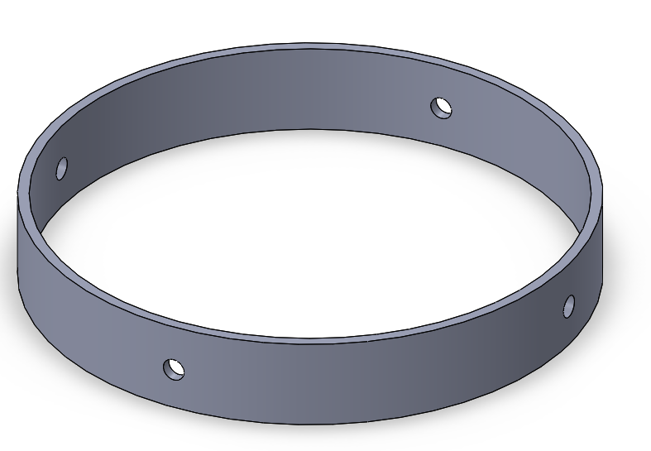
Department of Mechanical Engineering
Authors: Charlie Nitschelm, Andrew Hosman, Collin Stroshine, Ryan Blatti, Chase Eldridge, Tyler Landry, John Langer, Thomas Collins, Silas Johnson
Advisor: Dr. Todd Gross
Who We Are
A chapter of the Students for the Exploration and Development of Space, part of a nationwide organization
A second year engineering organization comprised of students of all classes and CEPS majors
A primary engineering goal of pursuing the art of high power rocketry with custom-made hybrid engines
Focused on giving its members a unique experience in the design and manufacturing of rockets and rocket engine components
Manufacturing
The combustion chamber and Injector plate were manufactured with the assistance of TURBOCAM International
Both components made of Aluminum 6061 for ease of manufacturing and Tripoli Experimental Rocket Recommendations
Injector plate designed so the plate can be reused, but hole inserts can be redesigned and replaced
The nozzle was manufactured here at UNH by Scott Campbell
Oxidizer Tank
A highly pressurized vessel that
contains liquid Nitrous Oxide,
acting as our oxidizer within
the combustion chamber
Flow Regulator
A motorized valve that monitors flow regulation
of the oxidizer into the injection plate controlled
by an electric motor and
an Arduino.
Injection Plate
Responsible for providing desired oxidizer flow into the combustion chamber with the assistance of the impinging plate
Cold Fire Test
A cold test fire was conducted to examine the oxidizer flow through the injector insert, and to determine the mass flow rate
Tested the flow regulation system
Attempted to determine how far we must open the flow regulator in order to get optimal flow through the injector plate
Project Overview
Our main focus is to develop a rocket propelled by a student designed hybrid engine
A hybrid rocket engine uses a solid reducer with the assistance of a liquid oxidizer
Compete in the Spaceport America Cup in June 2020 hosted in Las Cruces, New Mexico
A 10,000 ft. apogee competition implementing a student researched and developed hybrid class engine
Design and implement a device to enable the gimbaling of our hybrid rocket engine to control flight dynamics in real time
Impinging Plate
An interchangeable cylindrical plate responsible for the impingement and atomization of the oxidizer flow streams
Combustion Chamber
An enclosed volume where the solid reducer and liquid oxidizer react to produce a superheated, highly pressurized chamber of gas
Rocket Building Techniques
To begin designing and manufacturing a rocket engine, it is crucial to understand overall rocket design, mechanics and manufacturing techniques
Utilized last years members to teach and mentor new members on the lessons learned from last years research
Hosted multiple building sessions and in-house competitions to compete on highest altitude achieved
Learned the fundamental parameters that affect the performance of a rocket in flight, and tested first hand the effect of these design choices on the overall flight performance and path.
Project Field Safety
Must obtain a suitable location and testing infrastructure for safe testing procedures and events by communicating and negotiating with local officials
Design certain field structures needed for the development of testing and launching semi-permanent buildings
Nozzle
Graphite was machined into a de Laval curve responsible for directing the flow of hot gases outside of the combustion chamber into the environment providing thrust
Hot Fire Test
Engine Startup / Ignition Method
Correct ignition method to start-up the engine and provide initial heat and pressure for further combustion with the oxidizer
Obtain an initial injector flow rate
Hot Fire Testing Rig and Data Collection
Used to safely test the hybrid rocket engine in a static rig
Collect precise data on thrust, mass flow rate and combustion temperature for future optimization of the hybrid rocket engine geometry
Gimbal System
Preliminary design work was started last year on commercial off the shelf 29mm engines to assist in the application of those techniques on a larger, homemade hybrid engine
HHHHH
Two actuators will be utilized to control the pitch and yaw of our thrust vector through flight
An accelerometer will be used to sense any variation in our zenith direction, and quickly redirect our engine thrust to return back to the desired flight path
Reducer and Oxidizer
The fuel selected is Hydroxyl-terminated polybutadiene (HTPB), a commonly used hybrid reducer.
Liquid Nitrous Oxide was chosen as the oxidizer as it is commonly paired with HTPB and provided us with a great baseline of public knowledge
A mold was 3-D printed to insert into the combustion chamber and form the rubber to a specific grain formation in preparation for combustion and radial burn rate
Acknowledgments
A huge thanks to all the members of UNH SEDS, Scott Campbell, Dr. Ivo Nedyalkov, Dr. Alireza Ebadi, Sheldon Parent, Chief Dean, Ronald O’Keefe, TURBOCAM International, Reilly Webb and our advisor Dr. Todd Gross for all the support

